Slide 1
Curso Desarrollo Office 365
Marzo 2015

Slide 2


APIs para Apps de SharePoint Online: Modelo de Objetos en Cliente & API REST
Juan Carlos González (@jcgm1978)
Cloud & Productivity Advisor en MVP Clúster
MVP de SharePoint Server

Slide 3
Agenda
Overview de las APIs de Office 365 y SPO
Posibilidades de las APIs de SPO
API REST
Sabor JavaScript
Sabor .NET

Slide 4
APIs de Office 365
Directorio Activo de Azure
Exchange & Outlook.com
SharePoint
OneDrive
Sitios
OneDrive
Usuarios
Correo
Calendario
API de Cliente
OneDrive para Empresas
Sitios, Listas . Bibliotecas
Taxonomía
Grupos
Contatos
Workflow
BCS
Búsquedas
…

Slide 5
APIs de Cliente de SharePoint Online
Sitios, Listas y Bib.
Workflow
Búsqueda
Taxonomía
BCS
…
_api
Execute query
REST/ OData
Sabor JavaScript
Sabor Silverlight
Sabor .NET
Código de Cliente Personalizado (Aplicaciones Web, Aplicaciones de Escritorio, Aplicaciones de un Dispositivo)

Slide 6
_API – El poder está en tus manos
OAuth Enabled
Client/Server/Mobile Symmetrical
600+ Classes
_API
JSON
Declarative, Remote Events
Fully Remote
jQuery Compatible
OData
3000+ Methods
_api
Lists
Sites
Security
User Profiles
Taxonomy
Search
_api
Feeds
Publishing
Sharing
Workflow
E-Discovery
IRM
Private and Public Clouds

Slide 7
Posibilidades de las APIs para SPO

Slide 8
Arquitectura general del MO en Cliente
Client.svc
JSON XML
_api
Alineado con el
SSOM

Slide 9
Elementos que forman parte del MO en Cliente
Sabor JavaScript -
Bibliotecas específicas
Contexto
CAML
Posibilidades del MO Cliente
Colección de Sitios, Webs, Listas, Elementos de Lista, Vistas, Campos y Carpetas, elementos de Lista y Documentos
Schemas, Files, and Folders
Web Parts, Seguridad, Tipos de Contenidos, Plantillas de Sitios
Llamadas
Asíncronas
Conjunto de Ensamblados .NET
Contexto
CAML
Flujos de Trabajo, E-Discovery, IRM, BCS, Búsquedas, Traducciones, ---
Perfiles de usuario, Suministro de Noticias, Búsqueda, Taxonomía, Publicación
Llamadas
Síncronas
Llamadas de domino cruzado

Slide 10

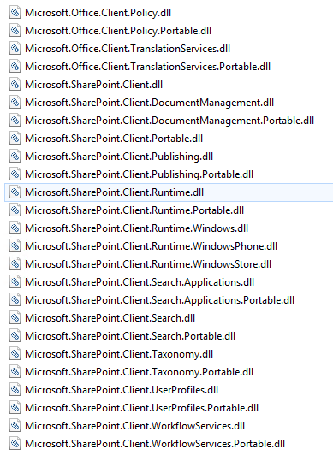
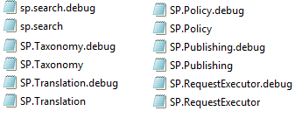
Elementos que forman parte del MO en Cliente
SPO Client SDK: http://www.microsoft.com/en-us/download/details.aspx?id=42038
Notes:
Ruta de instalación de los ensamblados: C:\Program Files\Common Files\microsoft shared\Web Server Extensions y en la GAC

Slide 11
REST vs. CSOM
HTTP Verbs
GET
POST
PUT
DELETE
_api
CSOM
REST
Context.Web.Lists
/_api/web/lists
Context.Web.Lists[guid]
/_api/web/lists(‘guid’)
JavaScript
jQuery
.Net
HttpWebRequest
HttpResponse
Web.Lists.GetByTitle ("Title")
/_api/web/lists/getbytitle(‘Title’)
Context.Web.Lists[guid].Fields
/_api/web/lists/getbytitle(‘Title’)/Field
Context.Web.SiteUsers
/_api/web/siteusers

Slide 12
REST vs. CSOM
Acceso consistente a datos y servicios:
API | REST URL | JavaScript | Client Namespace
Web | http://weburl/_api/Web | SP | Microsoft.SharePoint.Client
Search | http://weburl/_api/Search | SP.Search | Microsoft.SharePoint.Client.Search
Taxonomy | http://weburl/_api/Taxonomy | SP.Taxonomy | Microsoft.SharePoint.Client.Taxonomy
BCS | http://weburl/_api/BCS | SP.BCS | Microsoft.SharePoint.Client.BCS

Slide 13
API REST

Slide 14
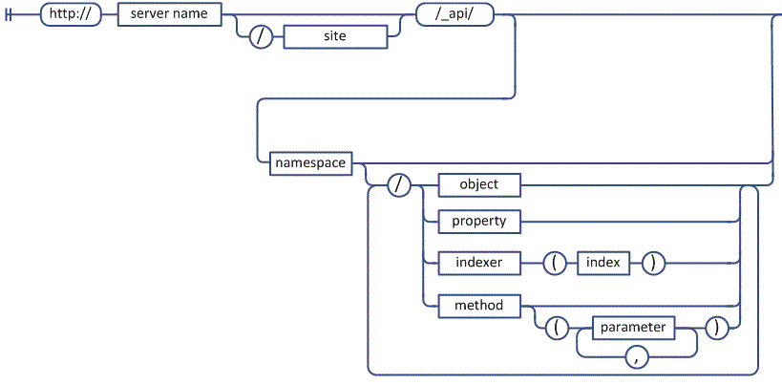
Fundamentos de REST para SPO
Patrón de generación de Urls:
Operaciones HTTP
PUT
GET
POST
DELETE
Soporte a para realizar llamadas a métodos con parámetros
Acceso a Servicios de SPO
…/_api/SP.UserProfiles.PeopleManager
…/_api/search
…/_api/publishing
…
Notes:
Ejemplos de parámetros: el Guid de una lista

Slide 15
API REST – Ejemplos de Urls
_api/web/lists
_api/web/lists/getByTitle('Announcements')
_api/web/getAvailableWebTemplates(lcid=1033)
_api/search/query?querytext=‘searchTerm‘
_api/social.feed/my/Feed
_api/social.feed/my/News
_api/social.feed/my/TimelineFeed

Slide 16
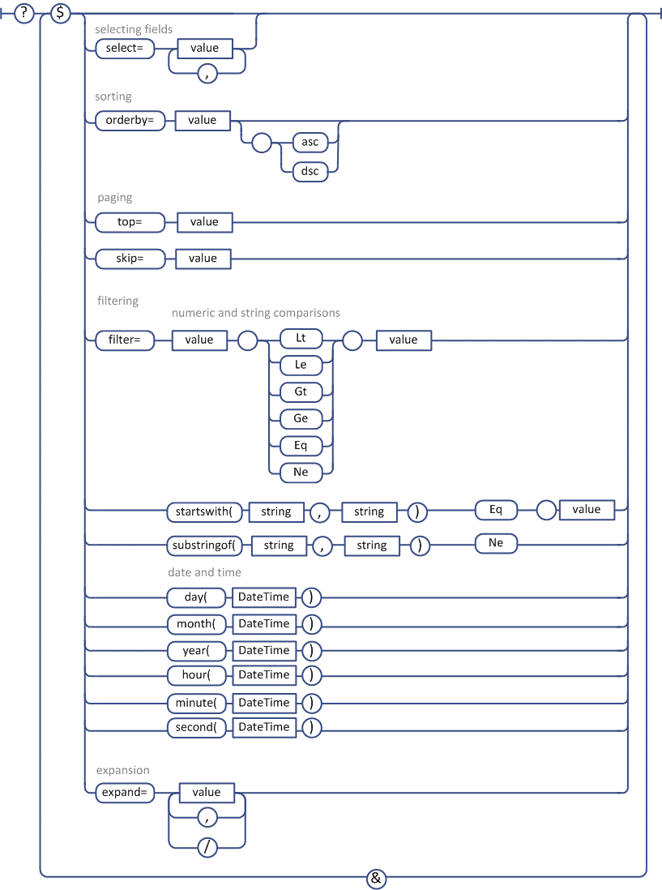
Soporte para OData (al menos 3.0)
_api/web/lists/getbytitle(‘Lista')/items?$Select=Title,EventDate
_api/web/lists/getbytitle(‘Lista')/items?$Filter=Categoria eq 'Trabajo‘
_api/web/lists('<guid>')/items$top=10
Extiende las funcionalidades de REST proporcionando operadores de consutla
Comando Select nos permite obtener columnas personalizadas
Comando Filter
nos permite realizar operaciones de filtro
Comando OrderBy nos permite realizar operaciones de ordnamieento

Slide 17
Soporte para OData (al menos 3.0)
Una URI OData consta de:
La URI raíz del servicio
La ruta al recurso que se quiere acceder
Unos parámetros de consulta
Notes:
To understand how to use OData as a developer, you must understand how OData URIs are constructed. Each URI has three significant parts, The first part of the URI is the Service root URI which points to a site on the Internet and a path to an entry point such as a .svc file. The next part of the URI is the Resource path which identifies a specific object such as a site, a collection (e.g list) or an entry (e.g. item). The final part of the URI are the optional query string parameters that allow you to request special processing instructions such as filtering and sorting.

Slide 18
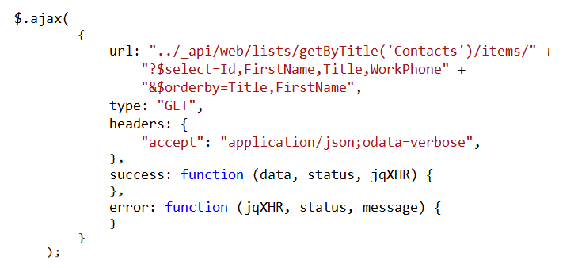
Uso de la API REST
Notes:
This is a READ sample. The other CRUD operations follow.

Slide 19
Uso de la API REST
ATOM XML vs JSON - Dos formatos de respuesta posible:
+ fácil de procesar desde código manejado
Hay que usar la cabecera “application/atom+xml” en las peticiones
+ manejable si se usa JavaScript (jQuery)
Hay que usar la cabecera “application/json”
Notes:
Response data format selected with ACCEPT header
XML can be easier to deal with from managed code. To get ATOM XML response use "application/atom+xml"
JSON is easier to deal with when using JavaScript. To get JSON response use "application/json"
When you run REST-based queries against SharePoint 2013 sites, you have the option of having the data returned as either XML in the ATOM format or JSON (JavaScript Object Notation). The default behavior is to return XML but you can change this default behavior to return JSON by including the ACCEPT header with a value of "application/json". If you include the ACCEPT header with an explicit value of "application/atom+xml", this has the same result as the default behavior in that the results are returned as ATOM-based XML.
As a general rule of thumb, it is easier to deal with XML-based results when writing managed code such as C# or VB.NET. Likewise, it is easier to deal with JSON results when programming with JavaScript. Note that jQuery makes dealing with JSON results even easier.

Slide 20
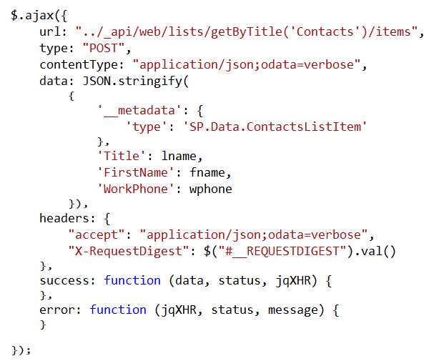
Crear un Elemento de Lista
X-RequestDigest:
(1) http://www.wictorwilen.se/sharepoint-2013-how-to-refresh-the-request-digest-value-in-javascript
Notes:
SharePoint 2013 (and previous versions) uses a client side “token” to validate posts back to SharePoint to prevent attacks where the user might be tricked into posting data back to the server. This token is known by many names;form digest or message digest or request digest. The token is unique to a user and a site and is only valid for a (configurable) limited time.

Slide 21
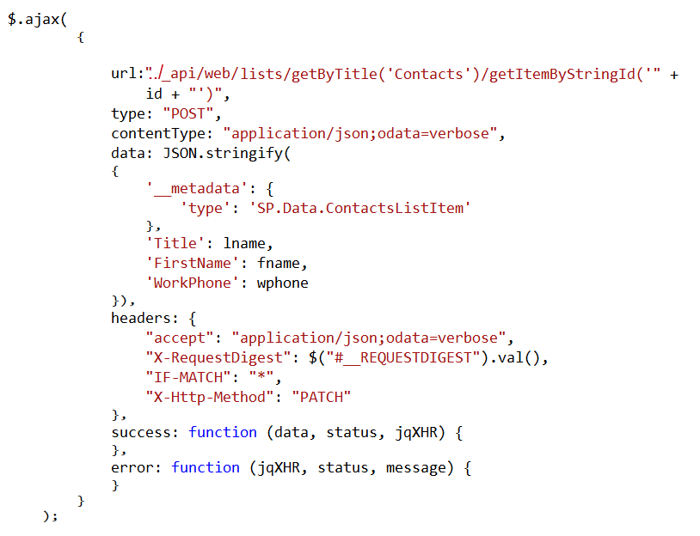
Actualizar Elementos de Lista

Slide 22
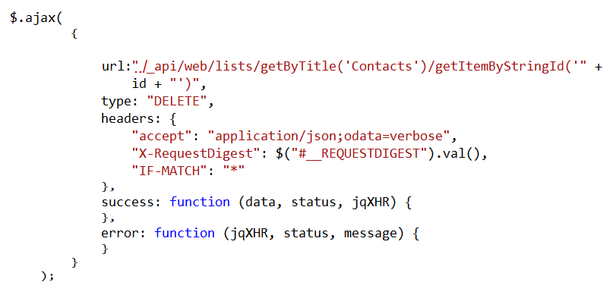
Borrar Elementos de Lista

Slide 23
Uso de la API REST – Código Manejado
Lectura de Información:
Usar los objetos HttpWebRequest y HttpWebResponse
Usar LINQ To XML para consultar los datos XDocument.Descendants
Notes:
Modificar con parte específica de SPO
--------------------------------------------------
If you are making REST calls into SharePoint 2013 using C# or VB.NET, there are a few tips to make things easier. First, .NET 4.0 added a two new classes named HttpWebRequest and HttpWebResponse which provide a few conveniences not offered by their base classes WebRequest and WebResponse. For example, there is a stongly-typed Accept property on the HttpWebRequest object that allows you to set the ACCEPT header.
When it's time to retrieve data values from elements within an XML document, it's time to abandon older XML APIs such as XMLReader in favor of Linq to XML and the XDocument class. Retrieving data from an XML document using the Descendants property of an XDocument object as shown above makes dealing with nested elements and XML namespaces so much easier.

Slide 24
Uso de la API REST – Código Manejado
Lectura de Información (2):
Usar los objetos HttpWebRequest y HttpWebResponse
También podemos leer la información en formato JSON
//REST URL
string sRESTUrl =
"https://itechcs.sharepoint.com/sites/CO365DeveloperSite/_api/web/lists";
//Petición Web
HttpWebRequest sphwrPeticion =
(HttpWebRequest)WebRequest.Create(sRESTUrl);
sphwrPeticion.Credentials =
new SPCOSM.SharePointOnlineCredentials(sSPOUser,ssPassword);
sphwrPeticion.Headers.Add(
"X-FORMS_BASED_AUTH_ACCEPTED", "f");
sphwrPeticion.Accept = "application/json;odata=verbose";
HttpWebResponse sphwrRespuesta =
(HttpWebResponse)sphwrPeticion.GetResponse();
StreamReader srReader =
new StreamReader(sphwrRespuesta.GetResponseStream());
string sData= srReader.ReadToEnd();
Notes:
Modificar con parte específica de SPO
--------------------------------------------------
If you are making REST calls into SharePoint 2013 using C# or VB.NET, there are a few tips to make things easier. First, .NET 4.0 added a two new classes named HttpWebRequest and HttpWebResponse which provide a few conveniences not offered by their base classes WebRequest and WebResponse. For example, there is a stongly-typed Accept property on the HttpWebRequest object that allows you to set the ACCEPT header.
When it's time to retrieve data values from elements within an XML document, it's time to abandon older XML APIs such as XMLReader in favor of Linq to XML and the XDocument class. Retrieving data from an XML document using the Descendants property of an XDocument object as shown above makes dealing with nested elements and XML namespaces so much easier.

Slide 25
Uso de la API REST – Código Manejado
Creación de Información:
Notes:
Modificar con parte específica de SPO y funcionando…
--------------------------------------------------
This slide shows the code which demonstrates creating a new list using client-side C# code which uses the new REST entry point. The first task it to parse together URL to point to lists collection which is _api/web/lists. The next task is to add the X-RequestDigest header which includes the value of the form digest. This example also sets the ContentType header to a value of application/atom+xml to tell SharePoint it is passing XML as opposed to JSON. Next, you must create an XML document that contains an Entry as defined by ATOM and conforms to the structure used by SharePoint 2013. The last task is to execute the request using an HTTP POST operation.

Slide 26

Demo – API REST
Notes:
API REST desde PowerShell y desde .NET

Slide 27
Sabor JavaScript

Slide 28
¿Por qué JavaScript?
Ejecución
en el lado del
Cliente
Servicio de Traducción de
Llamadas
Variedad de Herramientas
Desarrollo
Lenguaje
Dinámico
Mayor Cantidad Programadores
Web
JSON
XML
Muchos Frameworks JavaScript
jQuery
de serie en Apps de SharePoint

Slide 29
¿Qué posibilidades tenemos en SPO?
CSOM
ECMAScript
Servicios de
SharePoint
REST
OData
HTML
CSS

Slide 30
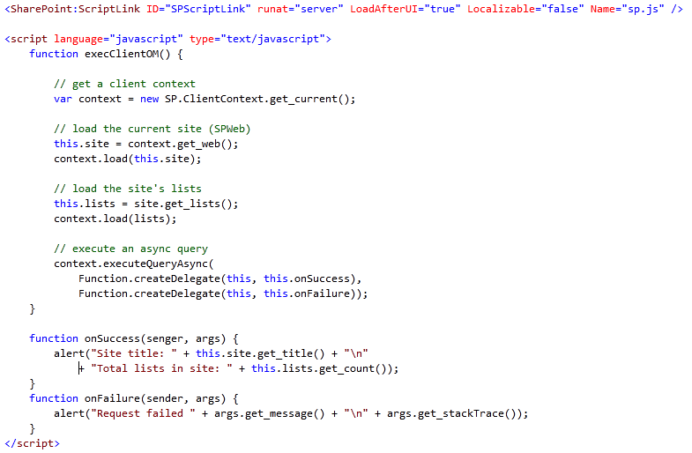
Uso del sabor JavaScript

Slide 31
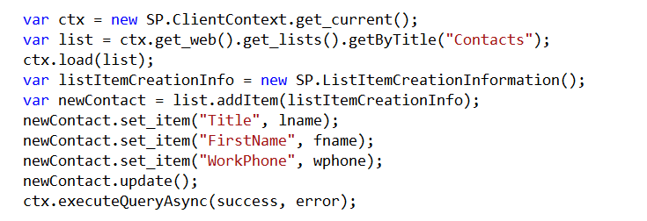
Crear Elementos de Lista

Slide 32
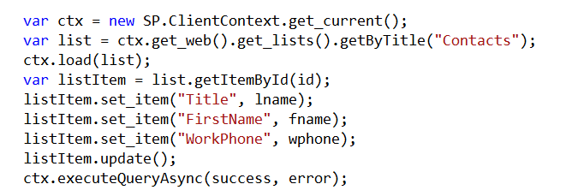
Actualizar Elementos de Lista

Slide 33
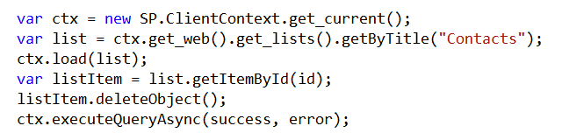
Borrar Elementos de Lista

Slide 34
Demo - JavaScript
Notes:
Demo de NAPA

Slide 35
Sabor .NET

Slide 36
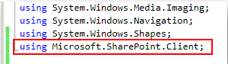
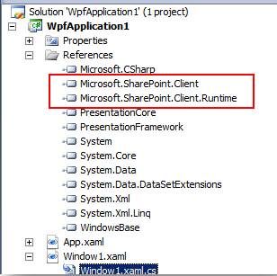
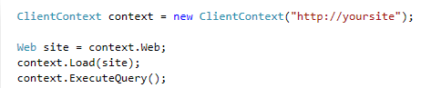
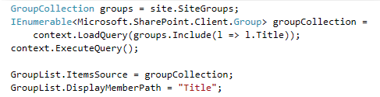
Uso del sabor .NET
Load() and LoadQuery() inicializan las propiedades
ExecuteQuery() realiza la llamada al servidor
Podemos tener excepciones de tipo PropertyOrFieldNotInitializedException
Notes:
Load() and LoadQuery() inicializan las propiedades.
ExecuteQuery() realiza la llamada al servidor.
Podemos tener excepciones de tipo PropertyOrFieldNotInitializedException.

Slide 37
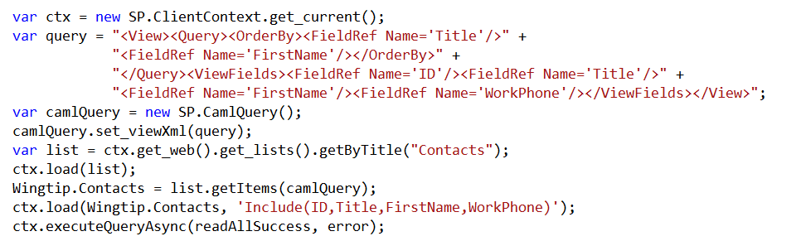
Uso del sabor .NET
Notes:
This is a READ sample. The other CRUD operations follow.

Slide 38
Demo - Sabor .NET
Notes:
SP 2013 Client Browser
CAML Designer
Scripts PowerShell: El de Obtener Sitios de una Colección, el de Flujos

Slide 39
Encuesta de Satifacción
http://www.metricsthatmatter.com/student/evaluation.asp?k=16302&i=892358

Slide 40
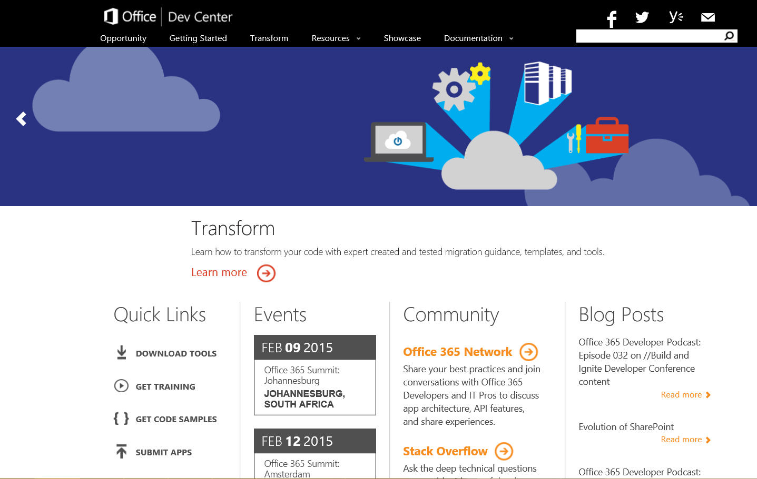
Dev.
Office
.com
One stop shop for Office Developer Platform

Slide 41

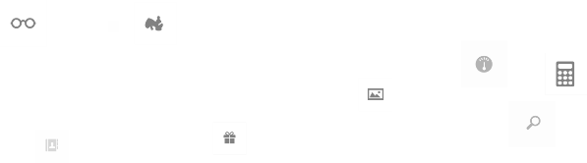

Calls to action
Explora el Centro de Desarrollo
http://dev.office.com
Fórmate http://dev.office.com/training
Juega con los Ejemplos de Código http://dev.office.com/code-samples
Obtén respuestas
http://aka.ms/AskSharePoint
http://aka.ms/AskOffice
Proporciona “Feedback” http://aka.ms/OfficeDevFeedback

Slide 42


Transforma tu código Proporciona Patrones del Modelo de Apps para escenarios comunes de código Full-Trust
+ 100 Proyectos de Visual Studio Escenarios Comunes
Branding
Provisionamiento de Sitios
Manejadores de Eventos Remotos
Soporte de archivos grandes
Navegación basada en meta-datos
Y muchos más…
Contribuye!!!
Developer
Patterns & Practices
https://github.com/OfficeDev/
Notes:
Transform your code - Providing App Model Patterns for common Full Trust Code scenarios
60+ Visual Studio projects Common scenarios

Slide 43
Cursos de Microsoft Virtual Academy
2014
2015
Deep Dive into integrating Office 365 APIs with your mobile device development
Deep dive into the building blocks and services of the SharePoint platform
Deep Dive into integrating Office 365 APIs with your standalone web application development
Introduction to Office 365 Development
Deep Dive into the Office 365 App Model
Deep Dive into Office 365 Development on non-Microsoft Stack
Shipping your Office 365 App to the Office Store
Aug
Sept
Oct
Nov
Dec
Jan
Feb

Slide 44

© 2014 Microsoft Corporation. All rights reserved. Microsoft, Windows, and other product names are or may be registered trademarks and/or trademarks in the U.S. and/or other countries.
The information herein is for informational purposes only and represents the current view of Microsoft Corporation as of the date of this presentation. Because Microsoft must respond to changing market conditions, it should not be interpreted to be a commitment on the part of Microsoft, and Microsoft cannot guarantee the accuracy of any information provided after the date of this presentation. MICROSOFT MAKES NO WARRANTIES, EXPRESS, IMPLIED OR STATUTORY, AS TO THE INFORMATION IN THIS PRESENTATION.

